Slide 1
Process Equipment Design-1
Dr. Koustab Ray
Dr. Swambabu Varanasi

Slide 2
What do you mean by design?
Let’s take a known example
You need a custom made computer table
As a customer, you need to provide your requirements
Laptop, some reading materials
Height from ground
Holding weight
Design engineer makes an estimate
Width and length
Material
Support legs design
Fabricator (carpenter)

Slide 3
Process equipment's
Unit operations
Heat transfer
Mass transfer
Mechanical operation
Unit processes
Reactors
– PED 1

Slide 4
What is the need heat transfer equipment's?
Illustrate with examples
Reactor
Atmospheric distillation column
Steam
Evaporator
Basics of heat transfer
What do you mean by design?
What is expected from a design engineer
Careers for design engineers

Slide 5
Course plan
Weekly syllabus/pattern
 | Topics | Instructor
Week 1 | Introduction, review of all heat transfer basics, mechanics design | KR and SV
Week 2 | Double pipe heat exchanges design | SV
Week 3 | Double pipe heat exchanges design | SV
Week 4 | Evaporator design | SV
Week 5 | Shell and Tube heat exchanges | KR
Week 6 | Shell and Tube heat exchanges | KR
Week 7 | Shell and Tube heat exchanges | KR
Week 8 | Reboiler design | KR

Slide 6
Evaluation procedure
Students are divided into groups and design problem will be given to each group.
Continuous evaluation procedure
Each group need to submit their report every Tuesday before 11:59PM
Online Quiz will be on
Week 2
Week 4
Week 6
Week 8

Slide 7
TA
TA Name | Course | Roll No | Email id and phone number
Prashant Kumar | PROCESS MODELING & SIMULATION {CH62003) | 16CH91R01
Shashwat Kumar |  | 19CH60R06
Abhishek Meena | PROCESS EQUIPMENT DESIGN-I {CH39023) | 19CH60R07
Ramachandram Poloju |  | 19CH60R15
Rajat Batish |  | 19CH60R25
Abhishek R Varma |  | 19CH60R26

Slide 8
Thumb rules in Heat Transfer
Take true countercurrent flow in a shell-and-tube exchanger as a basis.
Standard tubes are 3/4 in. OD, 1 in. triangular spacing, 16 ft long; a shell 1 ft dia accommodates 100 sqft; 2 ft dia, 400 sqft, 3 ft dia, 1100 sqft.
Tube side is for corrosive, fouling, scaling, and high pressure fluids.
Shell side is for viscous and condensing fluids.
Pressure drops are 1.5 psi for boiling and 3–9 psi for other services.
Minimum temperature approach is 20°F with normal coolants, 10°F or less with refrigerants.
Water inlet temperature is 90°F, maximum outlet 120°F.
Ref: Chemical Process Equipment Selection and Design by Stanley M. Walas et al.

Slide 9
Thumb rules in Heat Transfer
Heat transfer coefficients for estimating purposes, Btu/(hr) (sqft)(°F): water to liquid, 150; condensers, 150; liquid to liquid, 50; liquid to gas, 5; gas to gas, 5; reboiler, 200. Max flux in reboilers, 10,000 Btu/(hr)(sqft).
Usually, the maximum heat transfer area for a shell-and-tube heat exchanger is in the range of 5000 ft2 .
Double-pipe exchanger is competitive at duties requiring 100–200 sqft.
Compact (plate and fin) exchangers have 350 sqft/cuft, and about 4 times the heat transfer per cuft of shell-and-tube units.
Plate and frame exchangers are suited to high sanitation services, and are 25–50% cheaper in stainless construction than shell-and-tube units.
Ref: Chemical Process Equipment Selection and Design by Stanley M. Walas et al.

Slide 10
Air coolers: Tubes are 0.75–1.00 in. OD, total finned surface 15– 20 sqft/sqft bare surface, U = 80–100 Btu/(hr)(sqft bare surface) (°F), fan power input 2–5 HP/(MBtu/hr), approach 50°F or more.
Fired heaters: radiant rate, 12,000 Btu/(hr)(sqft); convection rate, 4000; cold oil tube velocity, 6 ft/sec; approx equal transfers of heat in the two sections; thermal efficiency 70–75%; flue gas temperature 250–350°F above feed inlet; stack gas temperature 650–950°F.
Ref: Chemical Process Equipment Selection and Design by Stanley M. Walas et al.

Slide 11



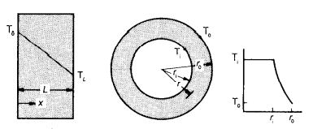





Heat Transfer Basics
Mode of heat transfer
Conduction – Fourier’s law
Convection – Newton’s law
Radiation – Stephen Boltzmann's law
$$Q=\frac{∆T}{\frac{1}{hA}}= \frac{∆T}{R_{}}$$
Rectangular slab
Cylindrical pipe – Hollow cylinder
$$Q=\frac{∆T}{\frac{L}{KA}}= \frac{∆T}{R_{w}}$$

Slide 12
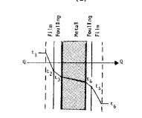
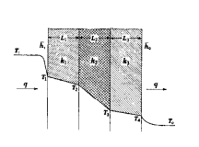
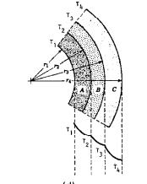




Heat Transfer Basics
When series of resistances
Fluid
Fluid
If the separator is a flat plate:
If it is a hallow cylinder:
overall heat transfer coefficient based
on the outside surface is
$R_{Overall}=R_{a}+R_{b}$+$R_{c}= \frac{1}{U A}$
Q = U A ΔT

Slide 13
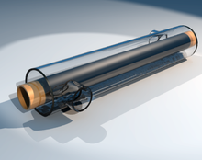
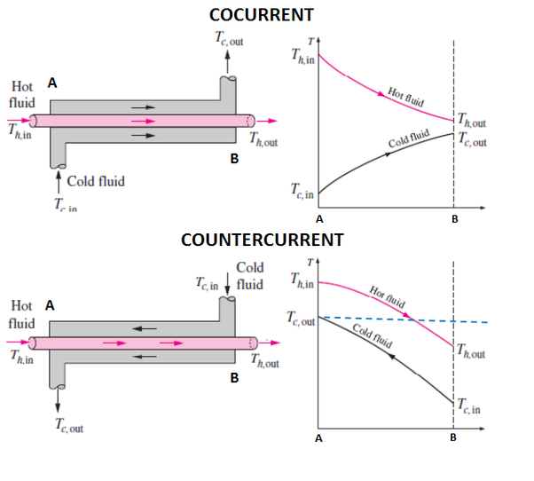

Heat exchanger
Exchanger normally transfers heat between fluid streams. Also, between a sold surface and a fluid or between solid particulates and a fluid
Q = U A ΔT_{LMTD}
Tubular Heat exchanger

Slide 14
Heat exchangers
Two types
Direct contact
For example, between immiscible fluids, gas-liquid or vapour-liquid
Indirect contact
Tubular heat exchangers
Double pipe
Shell and Tube
Spiral flow
Pipe coils
Extended surface can be plate fin or tube fin which can be fitted on either ordinary separating wall or pipe wall.

Slide 15
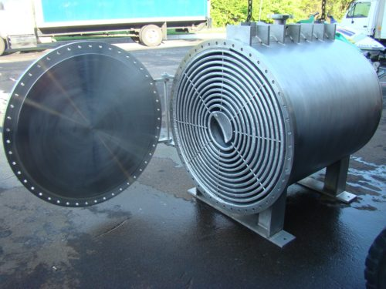
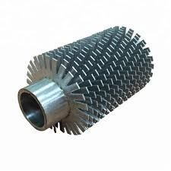
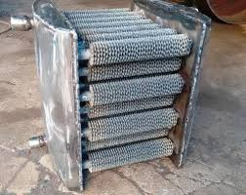

Slide 16
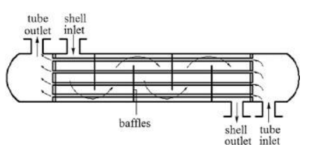
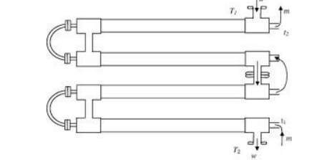

Slide 17
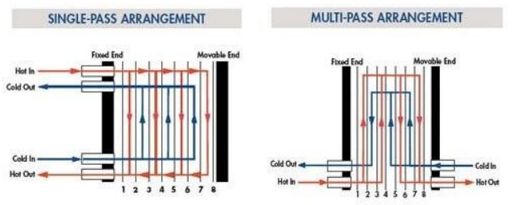

Slide 18
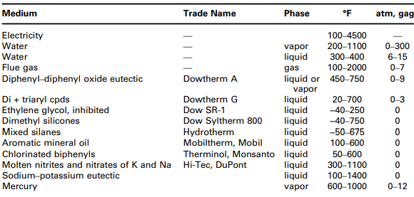
Heat transfer media

Slide 19
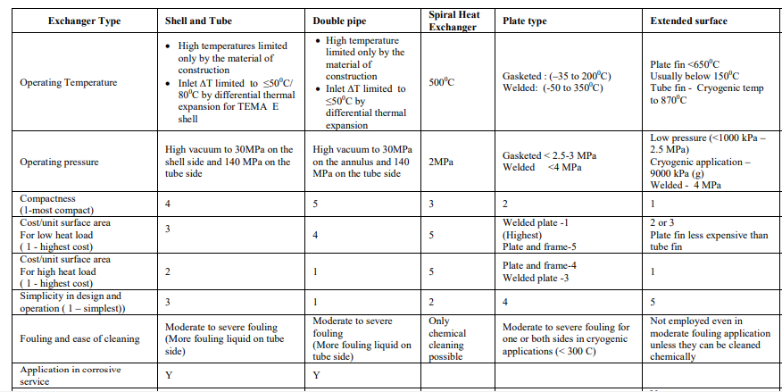

Slide 20
Reference books

